Slide 1
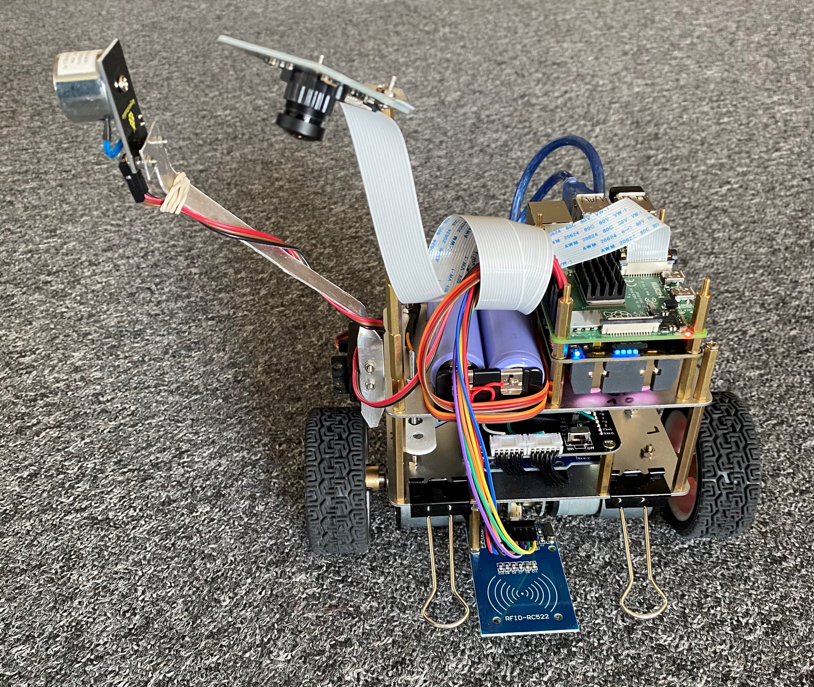

Overview of the hardware set-up of the 2-wheeled, self-balancing robot
wide-angle camera
Wifi to local PC for programming/launch
Wifi to AWS for data logging
electro-magnet
Raspberry Pi 4B
power sources
Servo
2 power sources
motors & angle sensors
accelerometer & gyro board
RFID reader
Arduino Uno
R. Bruckmeier, https://github.com/robbruck/RFID-robot

